Slide 1

A Web Data Dashboard for Covid-19 Analysis
Julia Poliak Peter Eckert Christoph Seng
Certification Project Data Scientist

Slide 2
Story
1. Data understanding and preprocessing - Julia Poliak
2. Data Analysis and first results - Julia Poliak
3. Prediction of future development - Peter Eckert
4. Web based Dashboard - Christoph Seng

Slide 3
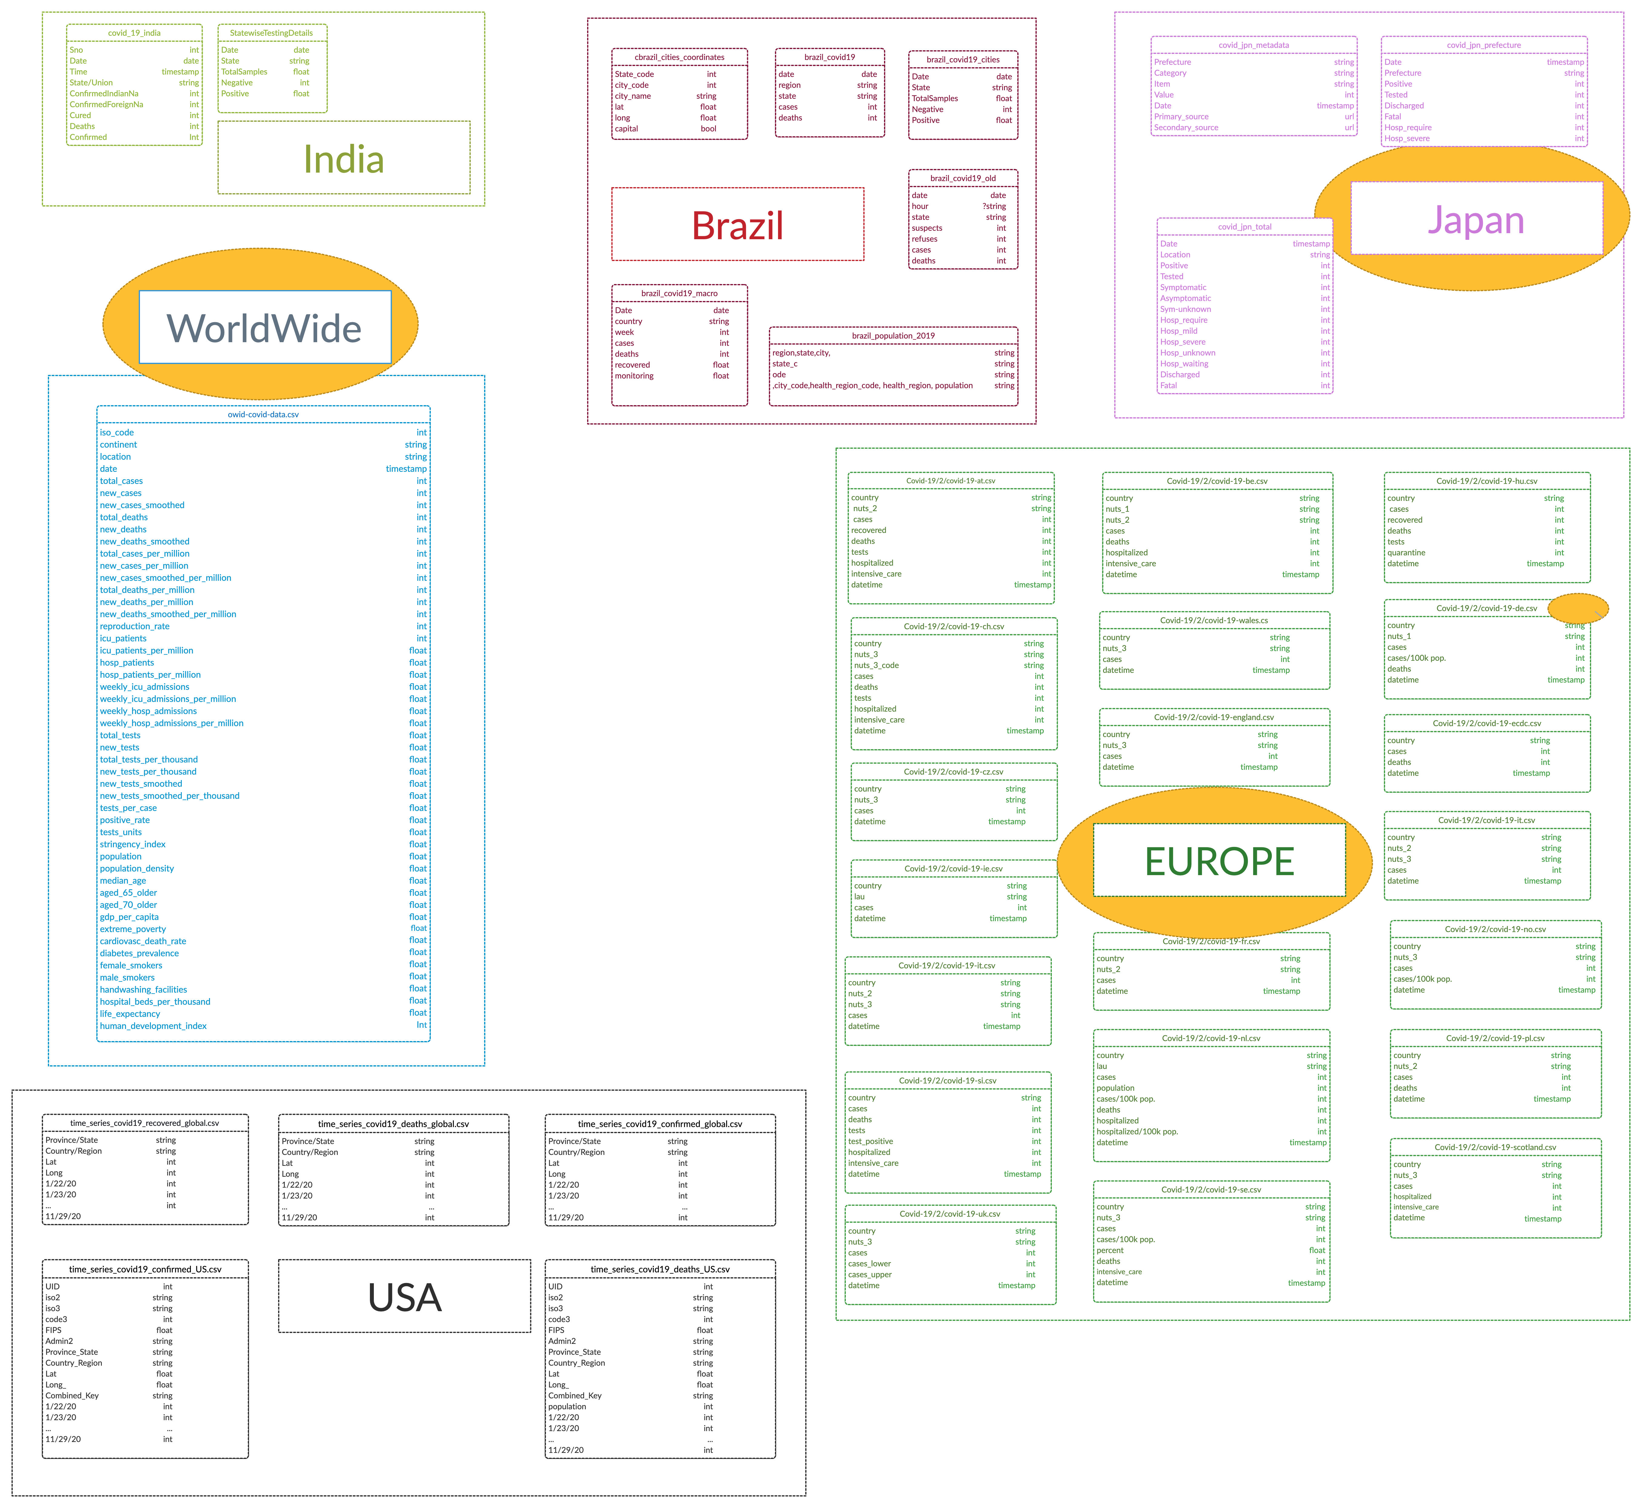
ER Model of Datasets
used 4 datasets
…

Slide 4
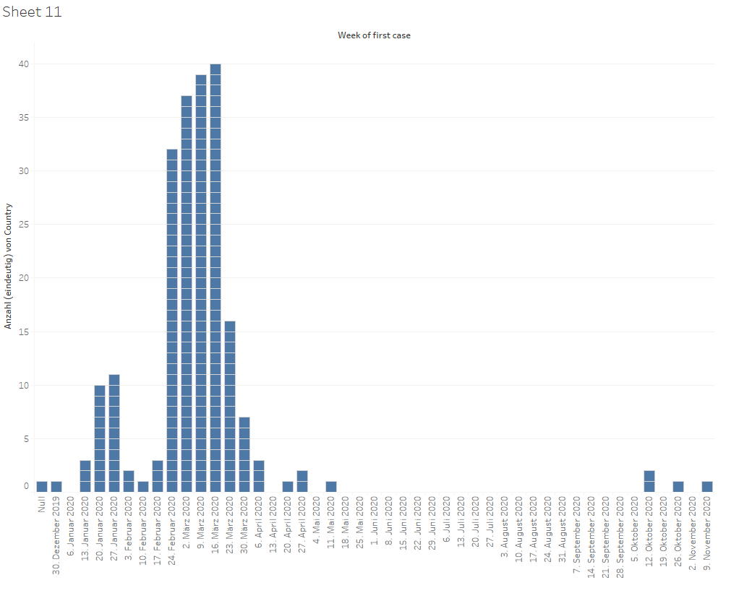
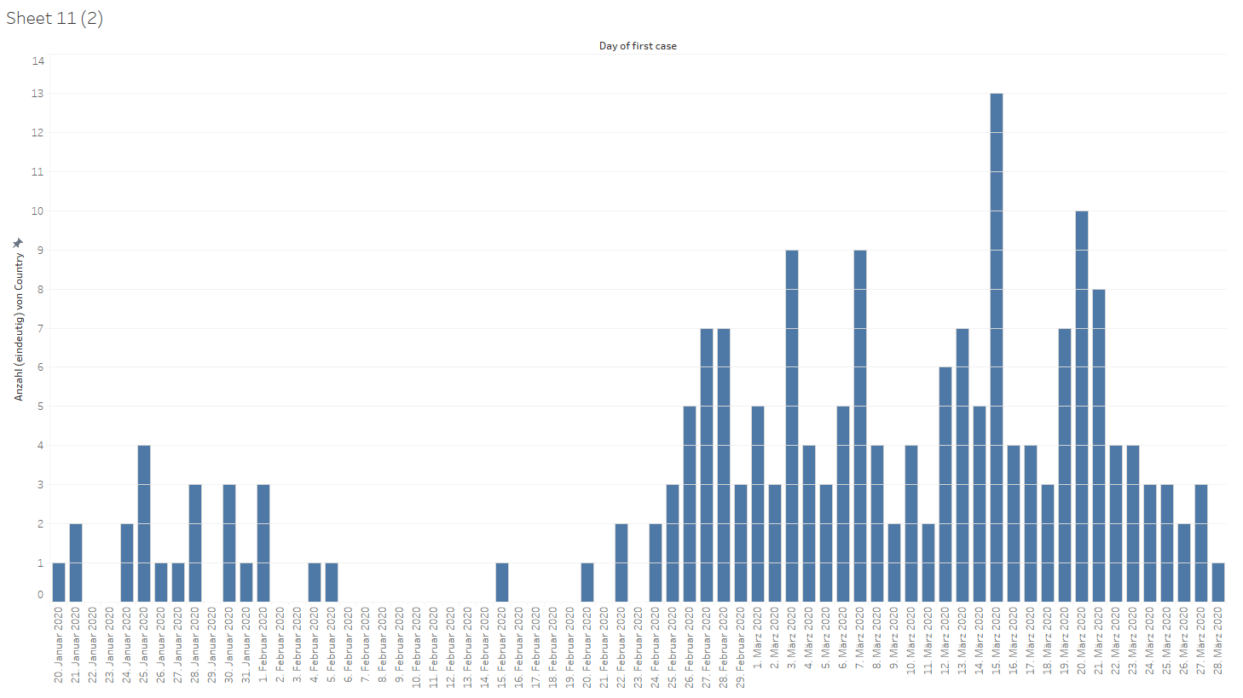
Data Analysis
start of contamination of each country
by week/by day
weeks
days

Slide 5
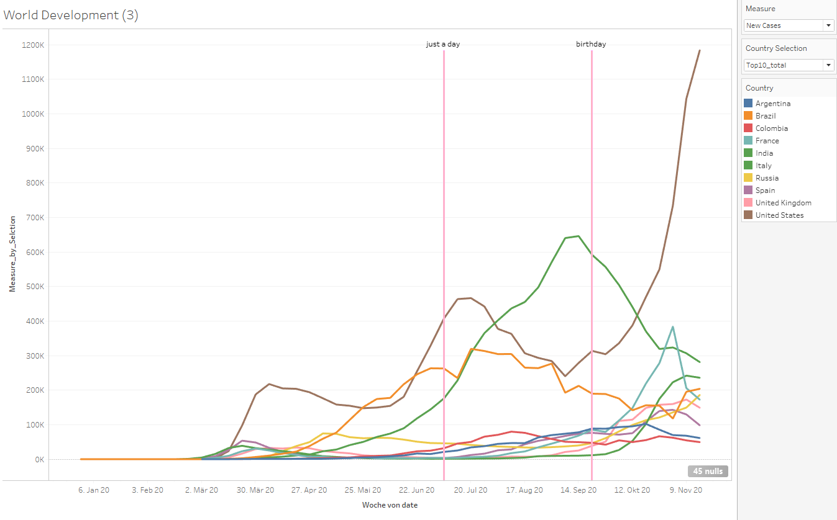
Data Analysis
Comparison of countries by the highest amount of incidents

Slide 6
Data Analysis
Comparison of Germany and Japan

Slide 7


Slide 8
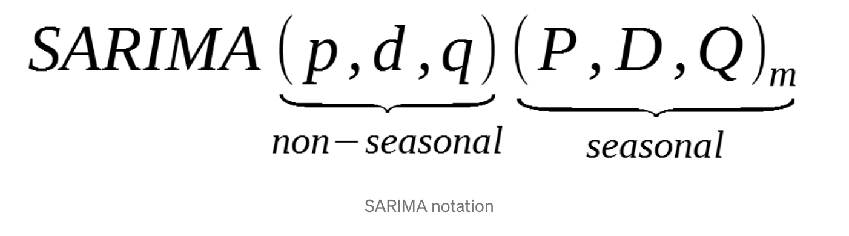
Prediction
country | p | q | d | P | Q | D | s | actual: new cases 29.11.2020 | predicted: new cases 7.12.2020
Germany | 6 | 2 | 1 | 1 | 1 | 2 | 7 | 14611 | 8275
USA | 0 | 2 | 1 | 1 | 1 | 4 | 24 | 154893 | 228418
Sweden | 5 | 3 | 1 | 1 | 0 | 2 | 25 | 5464 | 6114

Slide 9
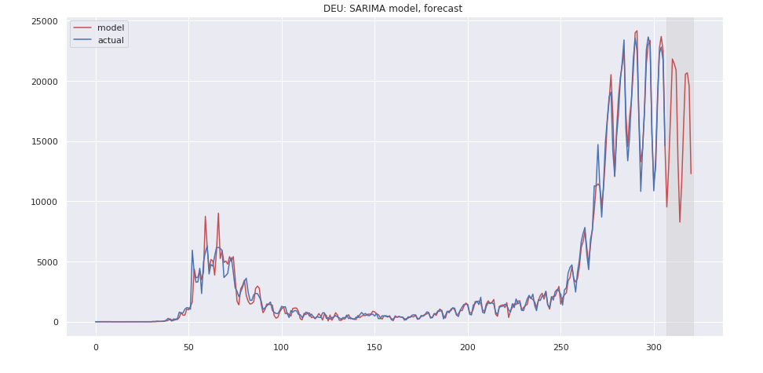
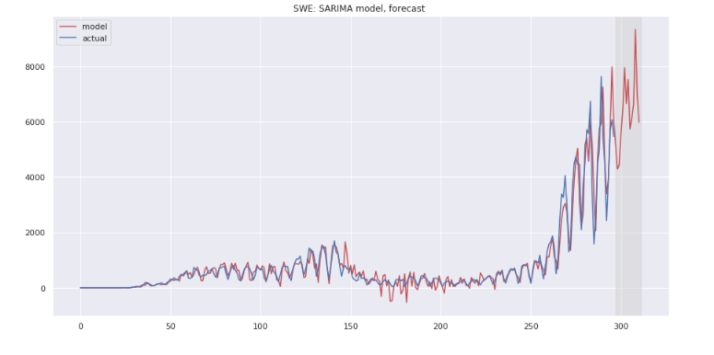
Prediction

Slide 10


Slide 11


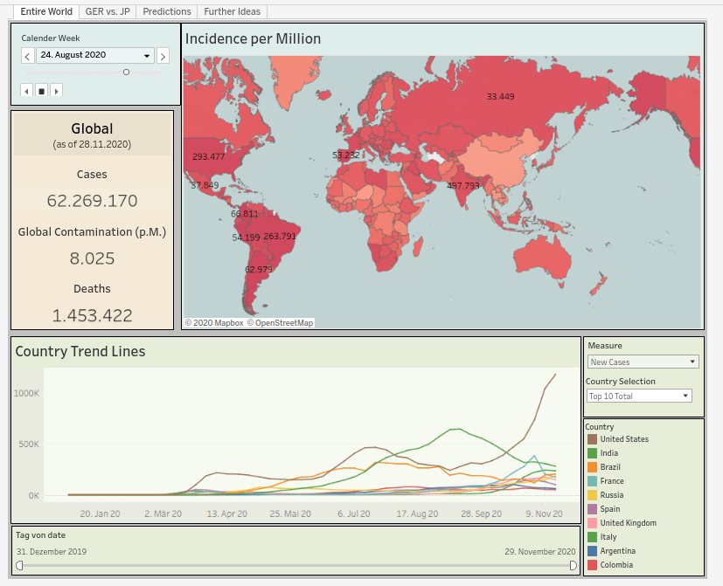
Web Based Dashboard
Live Demo
https://dub01.online.tableau.com/#/site/aidacovid/workbooks/524379?:origin=card_share_link

Slide 12

Thanks to Max
* * * * * * * * * * * * * * * * * * * * * * * * * * * * * * * * * * * * * * * * * * * * * * * * * *
and the AIDA Team

